Slide 1

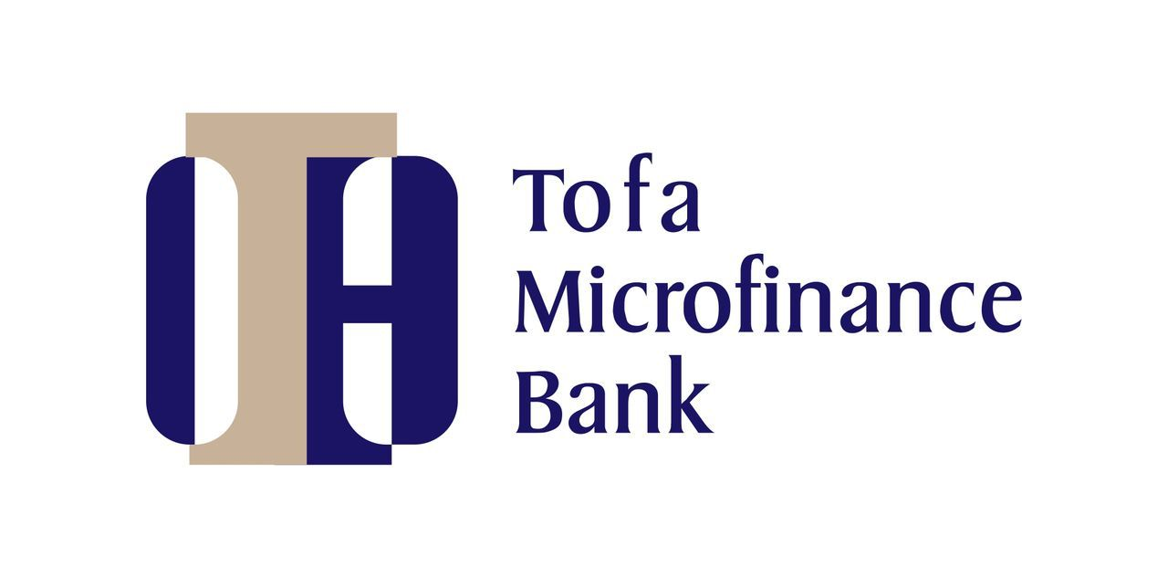
Banking Financial Report
1ST QUARTER 2025 DIGITAL

Slide 2

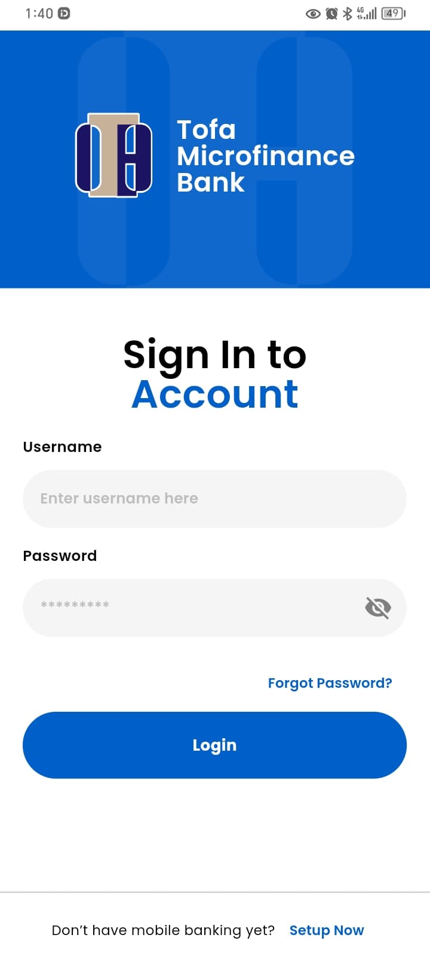
OVERVIEW
This report provides insights into all transactions carried out in the first quarter of the year using the new bank mobile application. The analysis covers various transaction types including interbank transfers, airtime purchases, data subscriptions, and utility bill payments, among others.
Objective of the Report
The primary aim of this report is to evaluate the performance of the bank's mobile application by identifying user preferences and transactional behavior. Specifically, the objectives include:
To determine the most and least utilized transaction types on the platform.
To assess the overall performance and effectiveness of the mobile application.
To provide data-driven predictions on future financial performance, including potential revenue and profit, to support strategic planning and budgeting decisions.

Slide 3

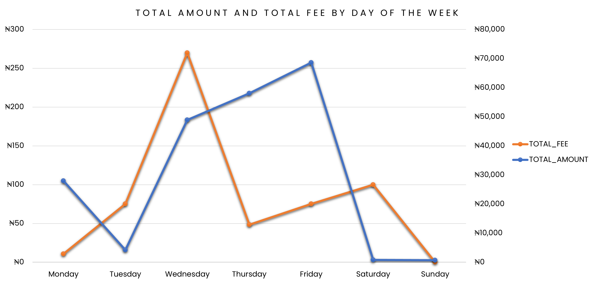
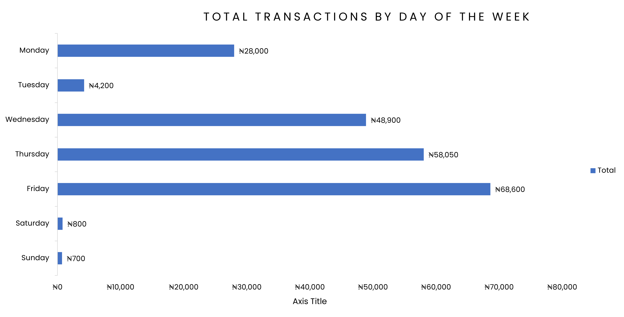
Total Transactions by Day of the Week
This provides a breakdown of total transaction amounts and associated fees for the week. The data reflects daily activity from Monday through Sunday.
Key Insights:
Day with Highest Transaction: Friday (₦68,600)
Day with Highest Fee : Wednesday (₦270)
Day with lowest Transaction : Sunday (₦700, ₦0 fee)
Day with lowest Fee : Monday (₦0)
₦68,600
₦700
₦270
₦0
Friday
Sunday
Wednesday
Monday

Slide 4
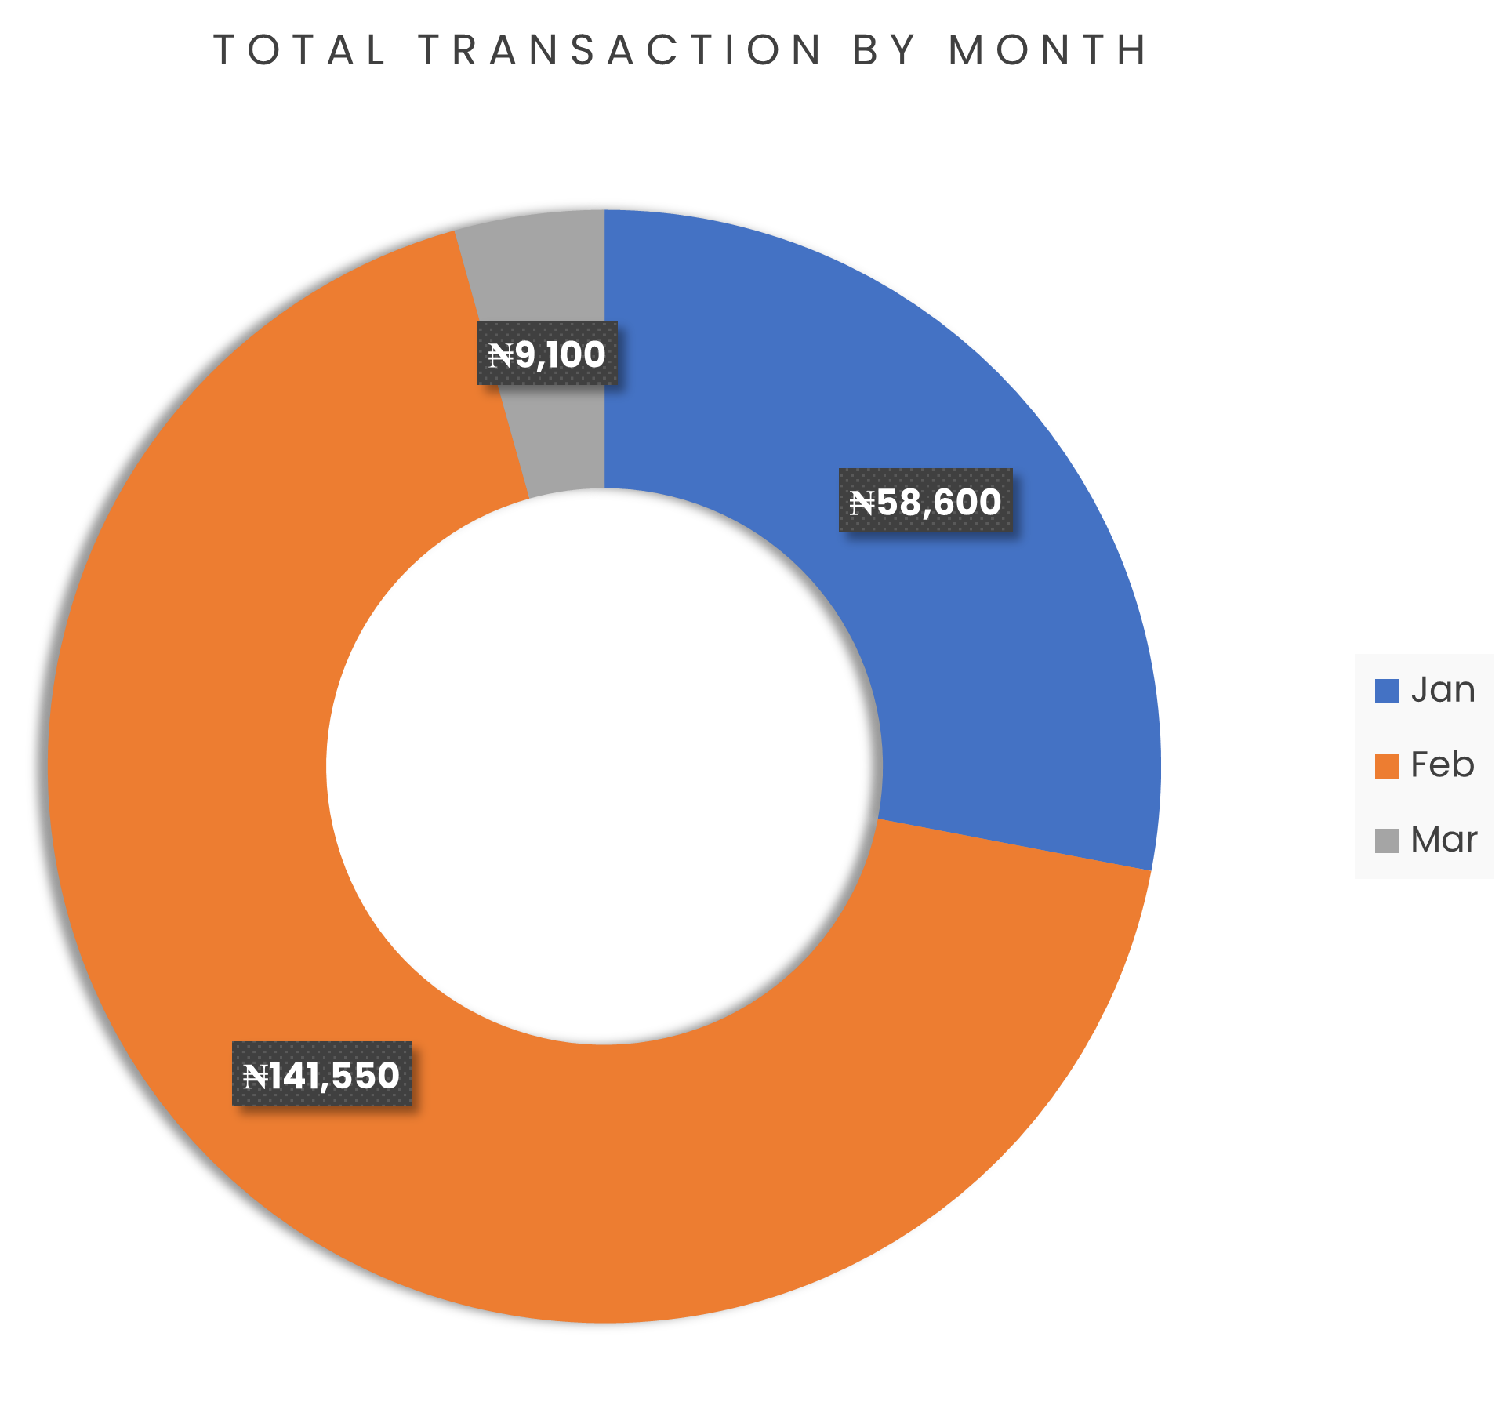
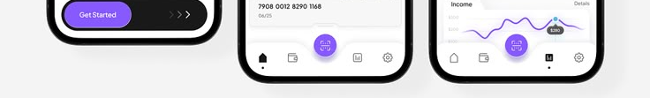
January
The total amount recorded in January was ₦58,600. This represents a modest start to the quarter and laid the foundation for the performance in the following months.
February
February saw a significant increase in activity, with a total of ₦141,550. This marks a 141% increase from January, indicating either higher revenue generation, increased inflows.
March
March recorded the lowest amount at ₦9,100. This sharp decline (-93.6% from February) suggests a drop-in financial activity, which is due to the network glitch that was experience for around 7days.

Slide 5
Volume of Transactions per Month
Report on the volume of transaction done for each month.
January
January recorded 30 transactions, marking the start of the quarter with moderate activity. This figure provides a useful benchmark for comparing the performance of subsequent months.
February
February experienced a noticeable increase with 42 transactions, the highest in the quarter. This represents a 40% increase over January, indicating a surge in customer engagement or operational activity.
March
March saw a slight dip to 41 transactions, but this did not reflect in the amount transacted in the course of the month due to the network glitch experience in the month, the high-volume experience in match was due to the transaction testing after the network was restored back.

Slide 7
REPORT ON THE TOP 5 QUARTERLY TRANSACTION.
1) NIP Credit Request Transaction remains the dominant channel in terms of transaction value, accounting for ₦142,000 or approximately 71.5% of the total top 5 transaction volume. However, this channel does not generate fee income because it is an inward credit transfer.
2) EazyPay Outward Funds Transfer is the second-largest channel, contributing ₦34,100 in volume and ₦268.76 in fees. This indicates a fee yield of 0.79%, making it the most profitable channel in this group based on fee-to-volume ratio.
3) Bills Payment Services, including general bill payments and specific top-ups like EKEDC Prepaid, together contribute ₦15,400 in volume and ₦200 in fees. This category, while lower in total volume, shows consistent fee income, indicating regular customer use for utility and prepaid services.
4) NIP Credit Transactions, though smaller in total volume (₦7,000), generate no fee income. This may warrant a review to assess potential revenue opportunities or ensure cost-effective servicing.
5) Bills Payment- EKEDC
Eko electricity is the least performing among the top 5 quarterly transaction but we can say it performed well and we should encourage more of bills payment because it comes with a fee.

Slide 8
The Head Office Branch has the highest amount of transaction for the 1st quarter, it also has the highest fee. This analysis shows a correlation between the total transaction and the fee charged for the 1st quarter.

Slide 9
Implementation of CBN-Mandated Charges on NIP Credit Transactions
The NIP Credit transaction recorded the highest transaction volume in Q1; however, it currently does not attract any charges. According to the CBN policy, every credit transaction above ₦10,000 should incur a ₦50 charge. It is recommended that the software development team update the system to ensure compliance, so all credit transactions exceeding ₦10,000 are automatically charged the applicable fee.
Salary Payment into Tofa Bank Accounts
To boost customer engagement with the Tofa Bank mobile application, it is advised that staff salaries be paid directly into their Tofa Bank accounts. This initiative will promote the consistent use of the bank's digital service.
RECOMMENDATION
Promotion of EazyPay Outward Transactions
The bank should encourage the use of the EazyPay outward feature within the mobile application. This service generates a fee for each transaction, thereby increasing the bank's revenue. Promotions or incentives can be used to drive user adoption.

Slide 10
Revenue Transparency on Airtime and Data Purchases
It is recommended that the software be enhanced to display a breakdown of the percentage of revenue shared between the bank and telecommunications companies on airtime and data purchases. This will provide clarity on the actual earnings the bank derives from these services.
Promotion of Profitable Transaction Channels
Services such as EazyPay outward fund transfers, which currently generate higher fee income, should be actively promoted. Encouraging users to make interbank transfers via the mobile app will increase transaction volume and boost revenue.
RECOMMENDATION
Expansion of Bill Payment Services
Bill payments through the app have shown steady income potential. To maximize this, the bank should seek to expand its bill payment offerings by partnering with more utility service providers—such as those for Airtime, DSTV, and electricity subscriptions. Additionally, introducing new payment options like JAMB scratch card purchases can further increase revenue from bill payments.

Slide 11
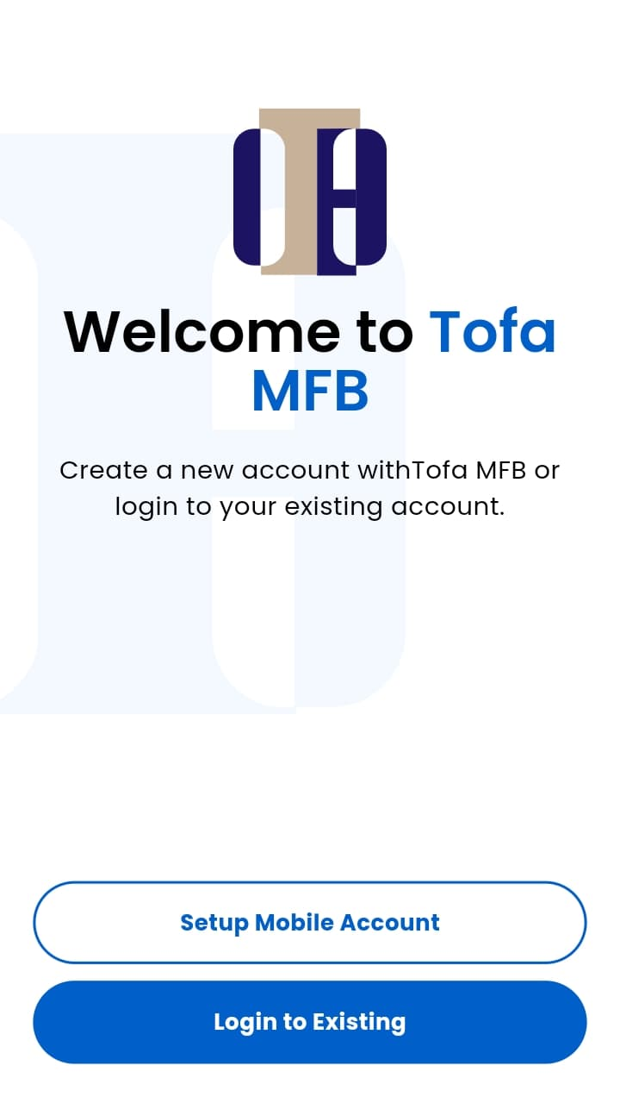

THANK YOU

